Slide 1
Hurricane Knight: My Life Story
Student’s Name

Slide 2
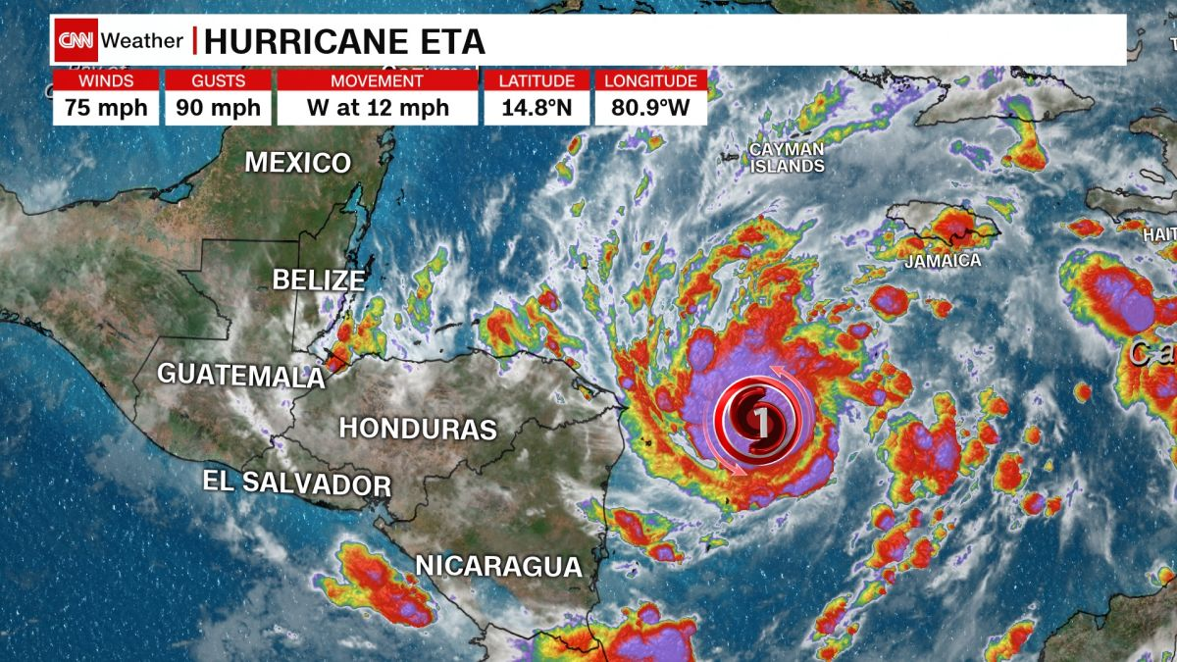
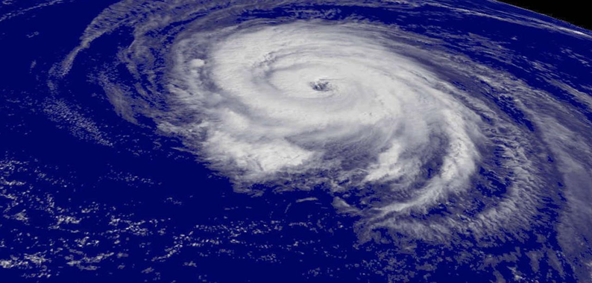
My Birth as a Storm
I was born when the wind speed within the tropical storm escalates beyond 74 mph and ocean temperature above 80 degrees Fahrenheit.
During this time, towering thunderstorms form rapidly near the center with a rapid rising motion leading to the development of my eye (Levina, 2020).
The essential ingredients for my tropical formation are warm air, humid air mass, and light winds.
These conditions explain why I mainly occur during the late summer because the currents in the upper level are light.
In this case, all the air within descends into the center of my eye.
As air sinks in the center of my eye, a clearing is formed.
An eyewall then surrounds my eye.
It should be noted that my eyewall is the most dangerous and destructive part of my formation. During this stage, I am in category 1.

Slide 3
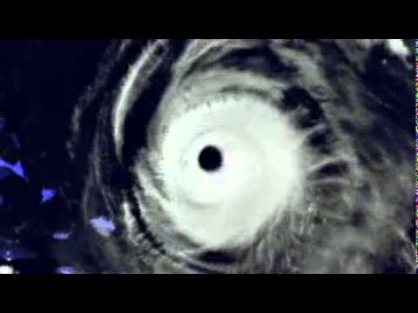
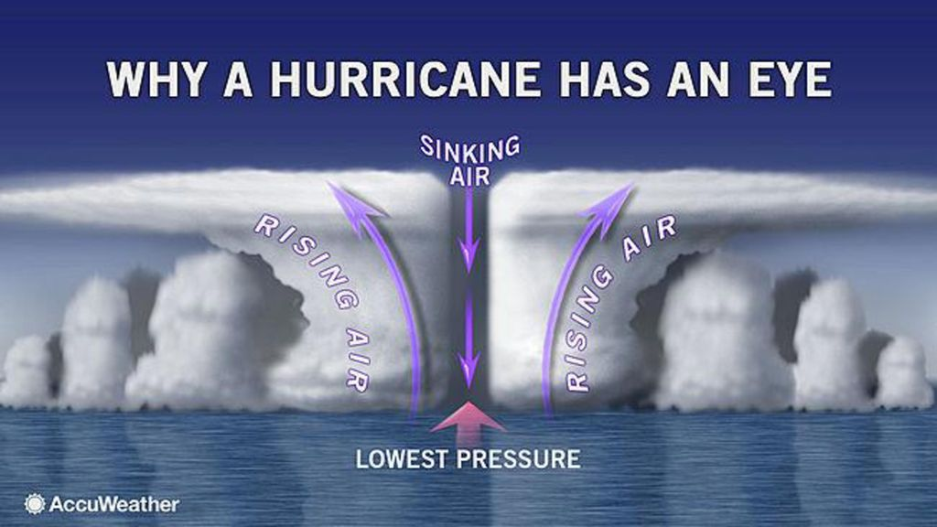
My Birth as a Storm
I was born in the tropical central Atlantic Ocean because during summer, the region offers hot temperatures that promote a higher evaporation rate.
This adds more water vapor in the atmosphere, where warm air rises, cools and condenses from clouds that eventually form thunderstorms.
Also, the light winds in the region allow me to grow tall without disintegrating hence advancing into tropical development.
The Coriolis force steps in to allow my continual cycle of counterclockwise movement enabling me to grow strength-wise.

Slide 4
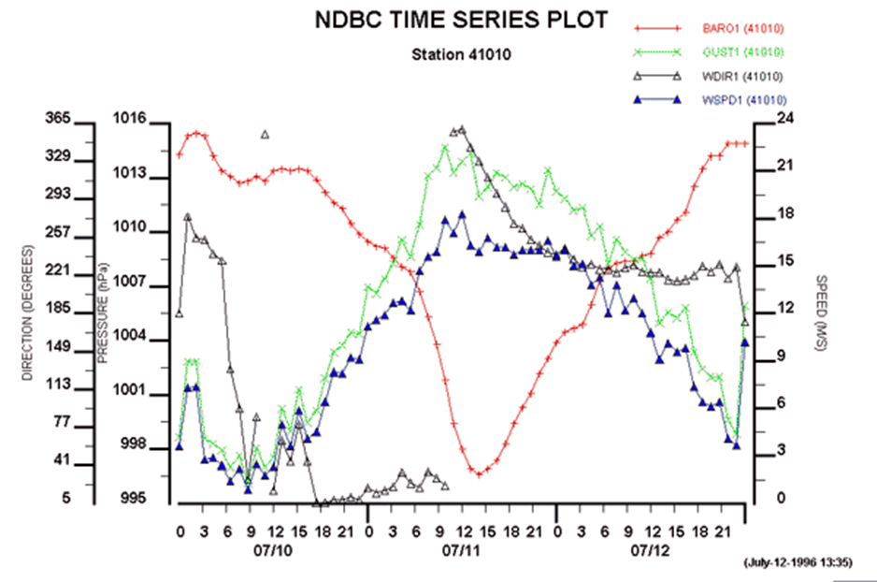
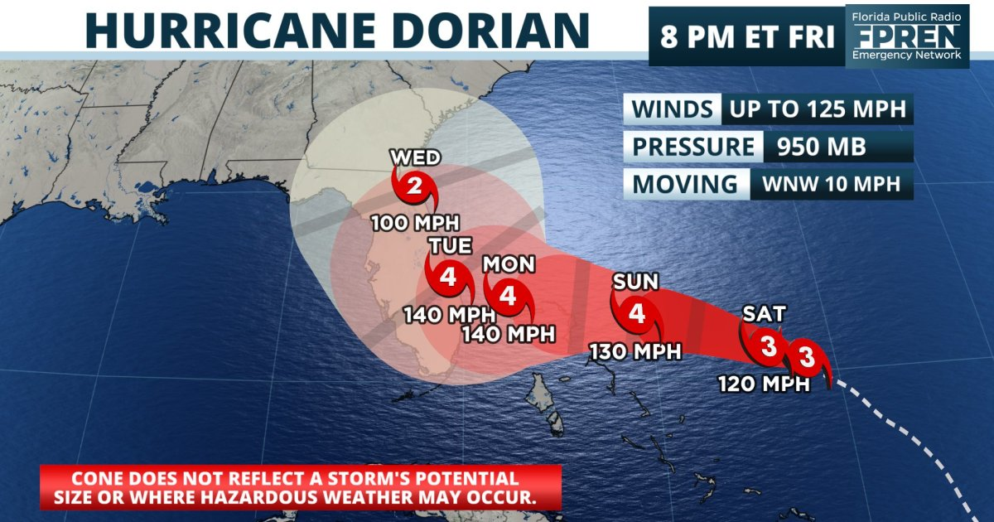
Early childhood and Why I’m gaining strength
I am comprised of intense storms that start from a small unorganized gathering.
From zero, I gain energy from the heat conserved by the Atlantic Ocean.
I started as a tropical depression gaining momentum to about 36 mph.
When I graduate into a tropical storm, my wind speeds increase to about 50 mph.
During this time, areas along the coast and beyond should get prepared for my change of mood.
When I hit a speed of 75 mph, I gain the needed momentum to swing into action by forming tongues of water towards the American coastline.

Slide 5
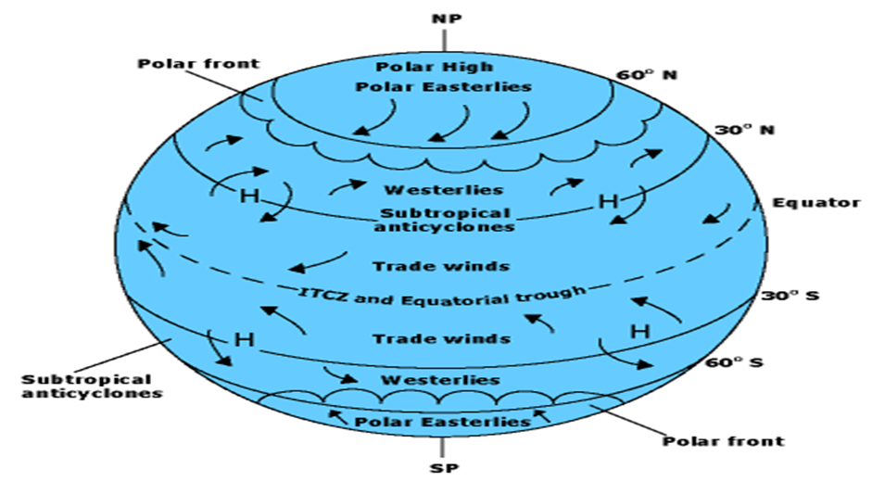
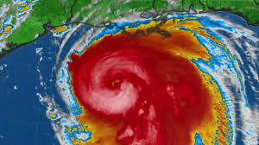
Early childhood and Why I’m gaining strength
My movement from one location to another is referred to as hurricane propagation.
I am generally steered by global winds and guided along my path by the prevailing winds that surround me.
Such winds are also referred to as the environmental wind field.
I always propagate in the direction of these wind fields that also determine my propagation speed.
In the tropics, the trade winds steer me in the westward direction, while in the Atlantic basin, the trade winds originate from the coast of Africa.
Such winds energize me, for they come at high speed.
If their high is positioned to the west and extends to the south, my storms are blocked from curving northwards.
I am forced to head westwards in such a scenario, putting a massive bulls-eye along with Florida. Cuba and the Gulf of Mexico at speeds more than 80 mph.

Slide 6
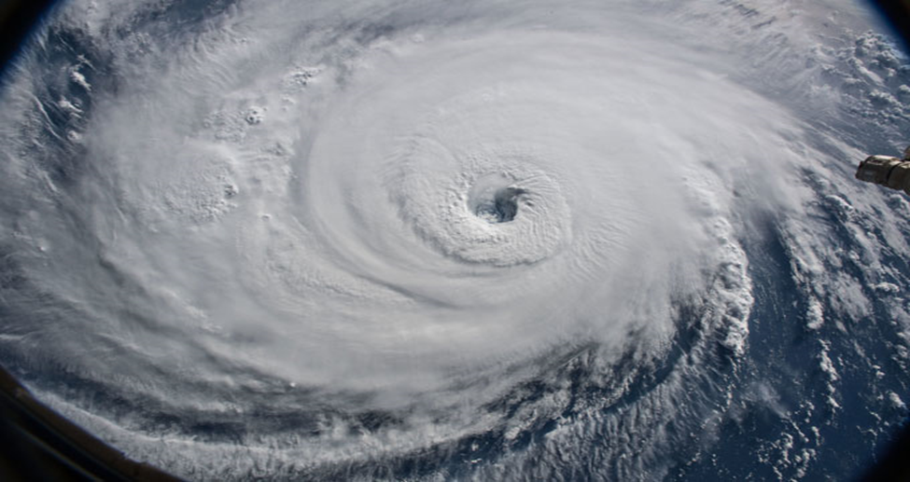
Teenage years and why My strength is dramatically increasing
My teenage years of typical transformation into a tropical storm are fascinating as nature itself.
As a tropical storm, I derive my strength from the wind speeds that increase by at least 35 knots.
This is an upgrade from my initial depression stage (Duran et al. 2019.
I vary in speed through between 35 and 64 knots as I become more organized.
The organization prepares me to in building and creating my needed strength.
Thus with time, I grow to resemble a hurricane due to the intensified circulation as a launching pad for destruction.
I form the tropical depression as I progress in gaining energy. I am not something to be brushed off with ease, though.

Slide 7
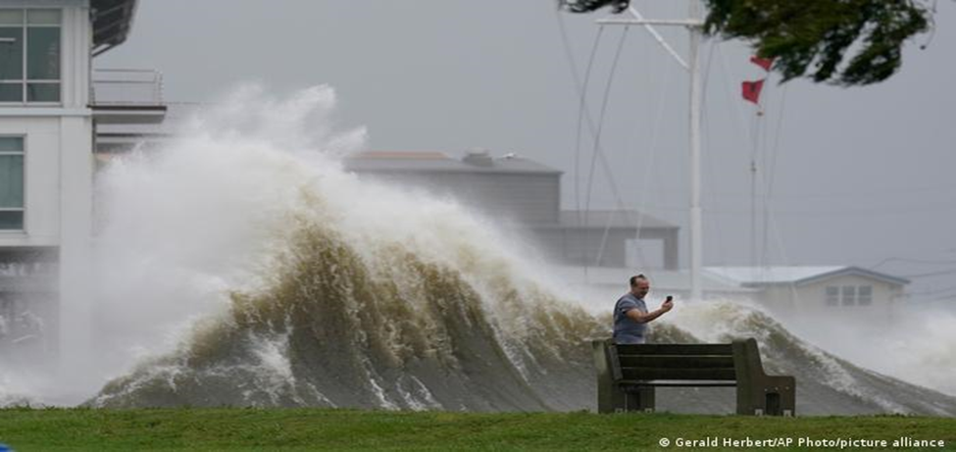
Teenage years and why My strength is dramatically increasing
As I grow in veto systematically, I form a system that eventually causes rains.
This formation that brings rains makes me capable of resulting in severe flooding capable of generating life in the area of my operation unbearable (Powell et al., 2020).
Through these floods, I sweep whatever I get in my way.
I result in this as a set in the weather patterns changes to those in my territory per se.
When I appear in heavy doses, I can cause landfall in areas where the soil is soft, in valleys and hills, and more dangerously in areas where trees are scarce.

Slide 8
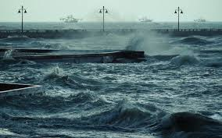
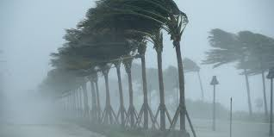
Early adulthood and a scenario where I run around and create destruction
After my teenage years of gunning for my strength, I graduated to a hurricane presumed to be my adulthood.
Having graduated, I pounce upon making things along and around the coastline a nightmare.
I form when surface pressures continue to drop, the presumed fact is that as the forces drop and drop, I come in the form.
Am perfectly enhanced and sustained by wind speeds that reach 74 mph.
The drop in pressure makes me lay a ground for destruction of anything in existence coupled with my speed winds that are relatively high in approximately seventy-four miles per hour (Duran et al, 2021).

Slide 9
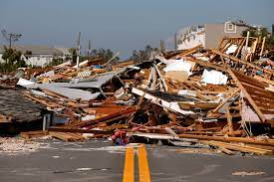
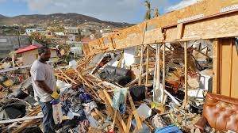
Early adulthood and a scenario where I run around and create destruction
As this unfolds, I take a final form of a hurricane as I ultimately form an eye that makes me completely recognizable.
Because of the high speeds of wind that create me, I make rotations that can eventually destroy well-constructed houses, large branches of trees will snap, shallowly rooted trees will be toppled.
I can eliminate the power lines causing power outages for days.
At this stage, I am judged by my tiers.
I derive this name for the reason of being located in the Atlantic, Central Pacific regions.
In other oceans, I go by the name typhoon or severe tropical cyclone.

Slide 10
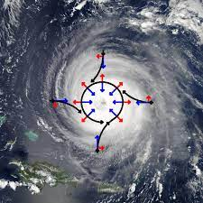
Being a responsible adult
Having gone through the teenage stage, and adulthood growing into a responsible adult is inevitable.
This is by the fact that it comes a time that responsible acts define an individual like me.
The act of responsibility chats a course in life, creating and regaining strength for stability.
I power up as I float over the warm tropical waters, in progression which makes me stop powering, bringing me to stability and calmness.
Coriolis means the apparent force on the wind that prevents air from moving from high pressure to low pressure and instead causes the air to deflect, and the low-pressure center does not fill (Levina, 2020).

Slide 11
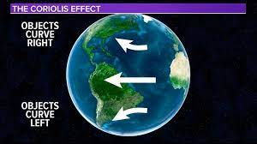
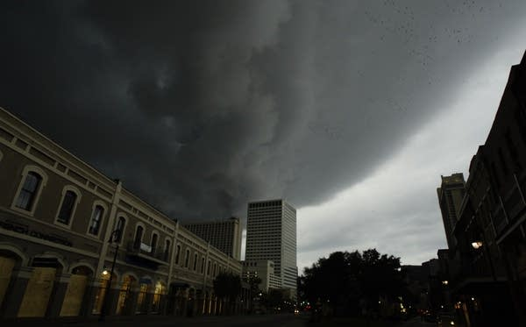
Being a responsible adult
Coriolis state has a great impact on my progress.
It causes the wind speed to drop.
This, in turn, stabilizes me, for I thrive on wind speed.
When the wind speed is stable am responsible for there is limited destruction due to the drop in speed of the wind.
To further advance my stabilization for my destructive nature, I decoratively form a feedback loop, and by good tides, I culminate in dissipation.
At this moment, I am less damaging for the formed stabilization that calls for calm, fronting a well-defined path in a life full of responsibility

Slide 12
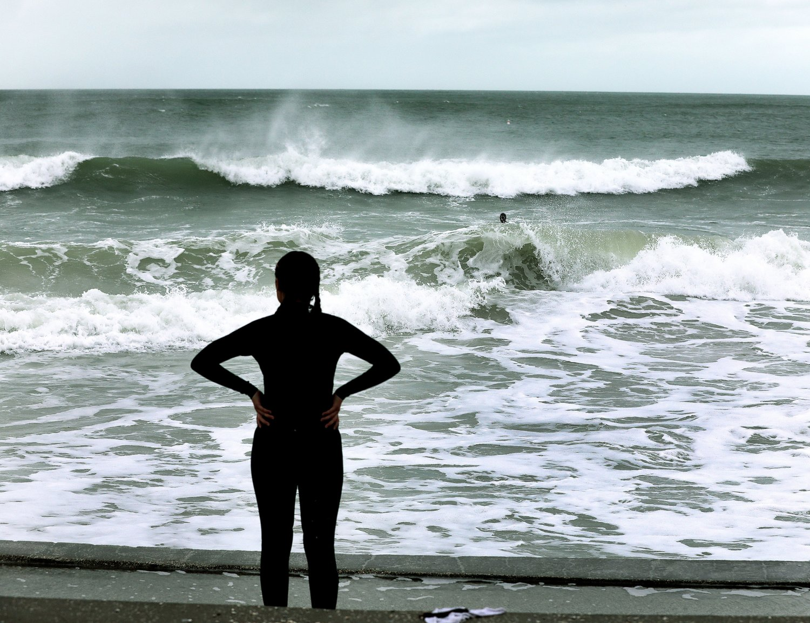
Mid-life Crisis
Me being docile is highly mistaken and taken for granted just because I am responsible, calm, and less destructive at this stage.
I become recollected thinking of what next but missing the point for me being in mid-life poses danger for I carry a crisis within that can be very deadly.
The crisis in me creates a platform for conflict and a recipe for a great degree of destruction.
I can traverse from category one to five.
At this stage, I lose my conscience and direction to intensify my wind speed, which makes me graduate from being dangerous to being catastrophic to mother nature, structures, and beings all in one (Duran et al., 2021).

Slide 13
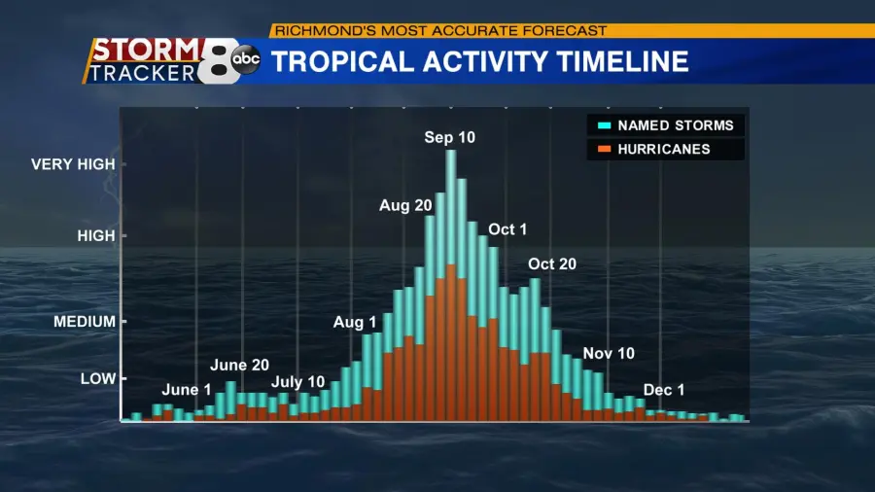
Mid-life Crisis
When I lose my sense of being, I destroy a high percentage of framed homes, with total roof failure and wall collapse.
The fallen trees I cause and power poles isolate homes, making homes habitable for quite some months.
Further, as a result, landfalls and trees roads are made impassable, denying affected areas of much-needed services and goods due to destroyed roads.
As a result, I make beings desperate to access and possibly supply needed assistance, but I disrupt them with my out sense of the act.

Slide 14
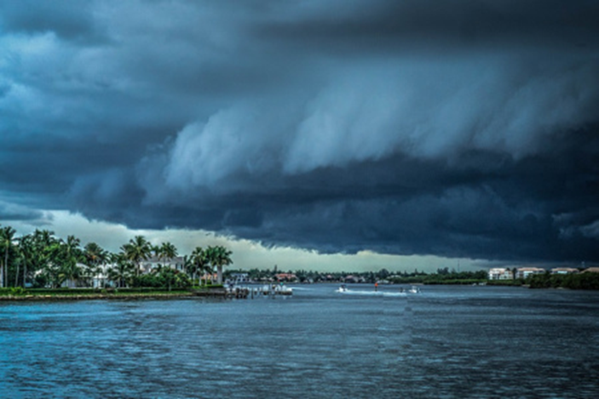
Retirement
Just like a crocodile, I have immense strength while steering in water.
I require evaporation from a warm ocean surface to survive.
Things change when I make a landfall where I am separated from my energy source in the ocean.
The separation disables my ability to siphon heat from the ocean. Land’s air masses are drier and contain aerosols.
This phenomenon makes me carry less moisture with me.
My cloud coverage lessens, my air cools and then sinks, disrupting my secondary circulation (Yan et al., 2017).
This also hinders my storm development. Also, the ruggedness of the land surface weakens me because increased frictions reduce my surface circulation.

Slide 15
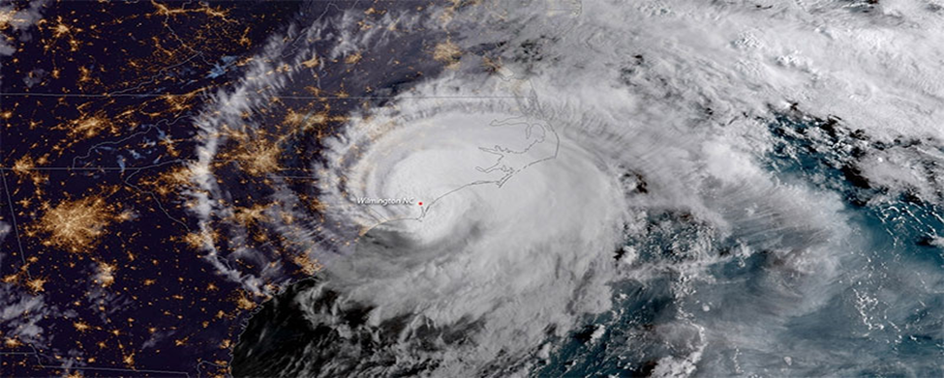
Retirement
Also, even if I move over the ocean, moving northwards from my comfort zone of the tropical ocean into the mid-latitudes, I become disadvantaged for moving over cold water.
This makes me lose the warm water source that drives me hence weakening me.
Other factors that cut me are the strong vertical wind shear (de Solo, 2021).
The speed with height and a change in wind direction.
A direction with height or a change in wind direction can encourage “the mixing of drier environmental air into storm eyewall leading to downdrafts which inhibit intensification.”
Speedy upper tropical winds create high values of wind shear, separating cloud tops from their bases.
This causes a vertical circulation around my eyewall to tilt.
With the advection of moisture and heat from my lower levels, my development is inhibited.
\The lack of secondary solid circulation reduces my strength and my typical destruction levels.

Slide 16
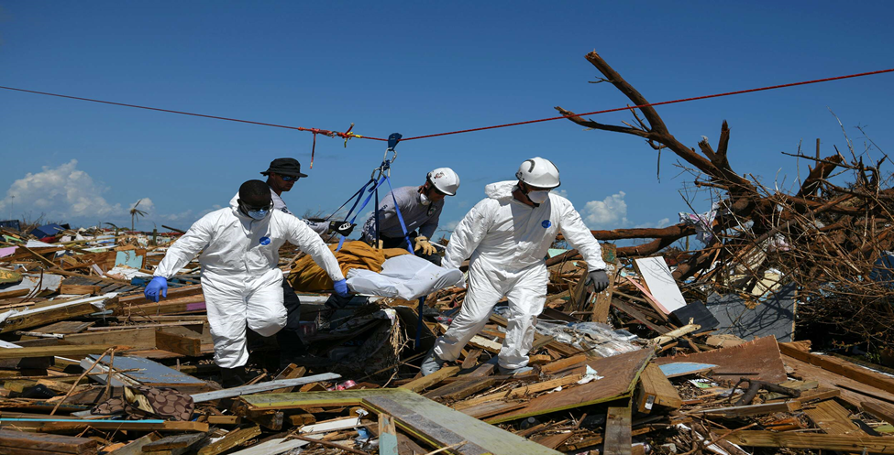
Death
The lack of secondary solid circulation to rejuvenate me leads to my untimely death.
My death can also occur, especially when I move into the mid-latitudes, where I get absorbed by the extratropical cyclone (a low-pressure weather system).
Despite my demise, human beings can remember me for the damage I caused.
My turbulent winds destroy houses and other outdoor property, leaving hundreds if not thousands of individuals homeless (Powell et al., 2020).
My winds also sweep through vegetation, distorting the once beautiful coastal scenery that attracted dozens of tourists.
I pluck off leaves and branches, causing dramatic structural changes in the wooded habitats.
Aquatic birds will remember me for forcing them to fly in my eye as they escape my wrath.

Slide 17
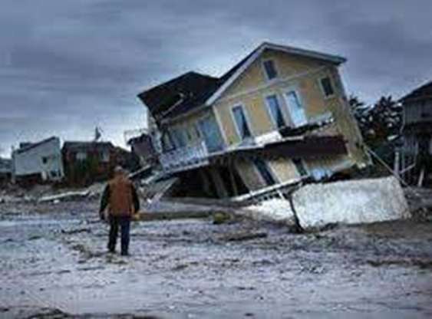
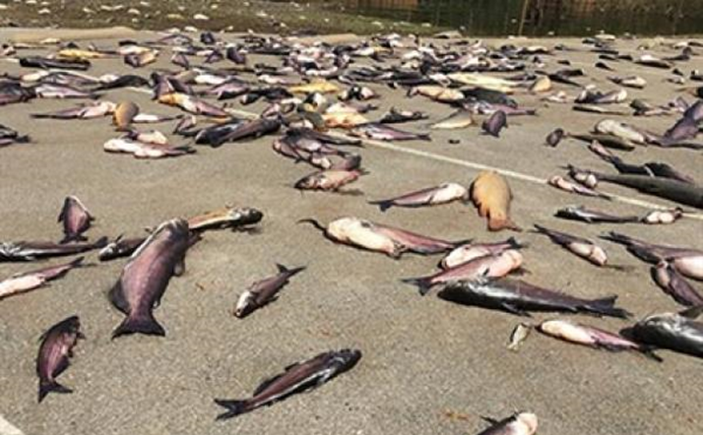
Death
The individuals, including the government, will remember me for spending many funds that could have been used in meaningful activities in rebuilding shelters and other physical infrastructure (Powell, 2020).
My flooding not only destroy property but also claim lives.
As much as houses and cars float like matchboxes, many people drown trying to escape my wrath.
I never spare the aquatic life too.
Big fishes, for instance, sharks and whales, are swept ashore and left for the dead.
Those who lack the fishing skills can remember me sweeping thousands of fish on the shore for easy harvesting.

Slide 18
References
de Solo, S. M. (2021). What makes a hurricane fall apart? A multi-platform assessment of tropical cyclone weakening By.
Duran, P., Schultz, C. J., Bruning, E. C., Stevenson, S. N., PeQueen, D. J., Johnson, N. E., ... & LaFontaine, F. J. (2021). The Evolution of Lightning Flash Density, Flash Size, and Flash Energy During Hurricane Dorian's (2019) Intensification and Weakening. Geophysical Research Letters, 48(8), e2020GL092067.
Levina, G. V. (2020, October). Birth of a hurricane: early detection of large-scale vortex instability. In Journal of Physics: Conference Series (Vol. 1640, No. 1, p. 012023). IOP Publishing.
Powell, T. M., Yuma, P. J., Scott, J., Suarez, A., Morales, I., Vinton, M., ... & Li, S. J. (2020). In the aftermath: The effects of hurricanes Harvey and Maria on the well-being of health-care and social service providers. Traumatology, 26(3), 298.
Yan, X., Zhang, R., & Knutson, T. R. (2017). The role of Atlantic overturning circulation in the recent decline of Atlantic major hurricane frequency. Nature Communications, 8(1), 1-8.

